Slide 1
Cost-effective control of SO2 emissions in Asia
Research paper based on linear programming
ENV-723
14.03.2023
Abdurahman Alsulaiman
ENV-723

Slide 2
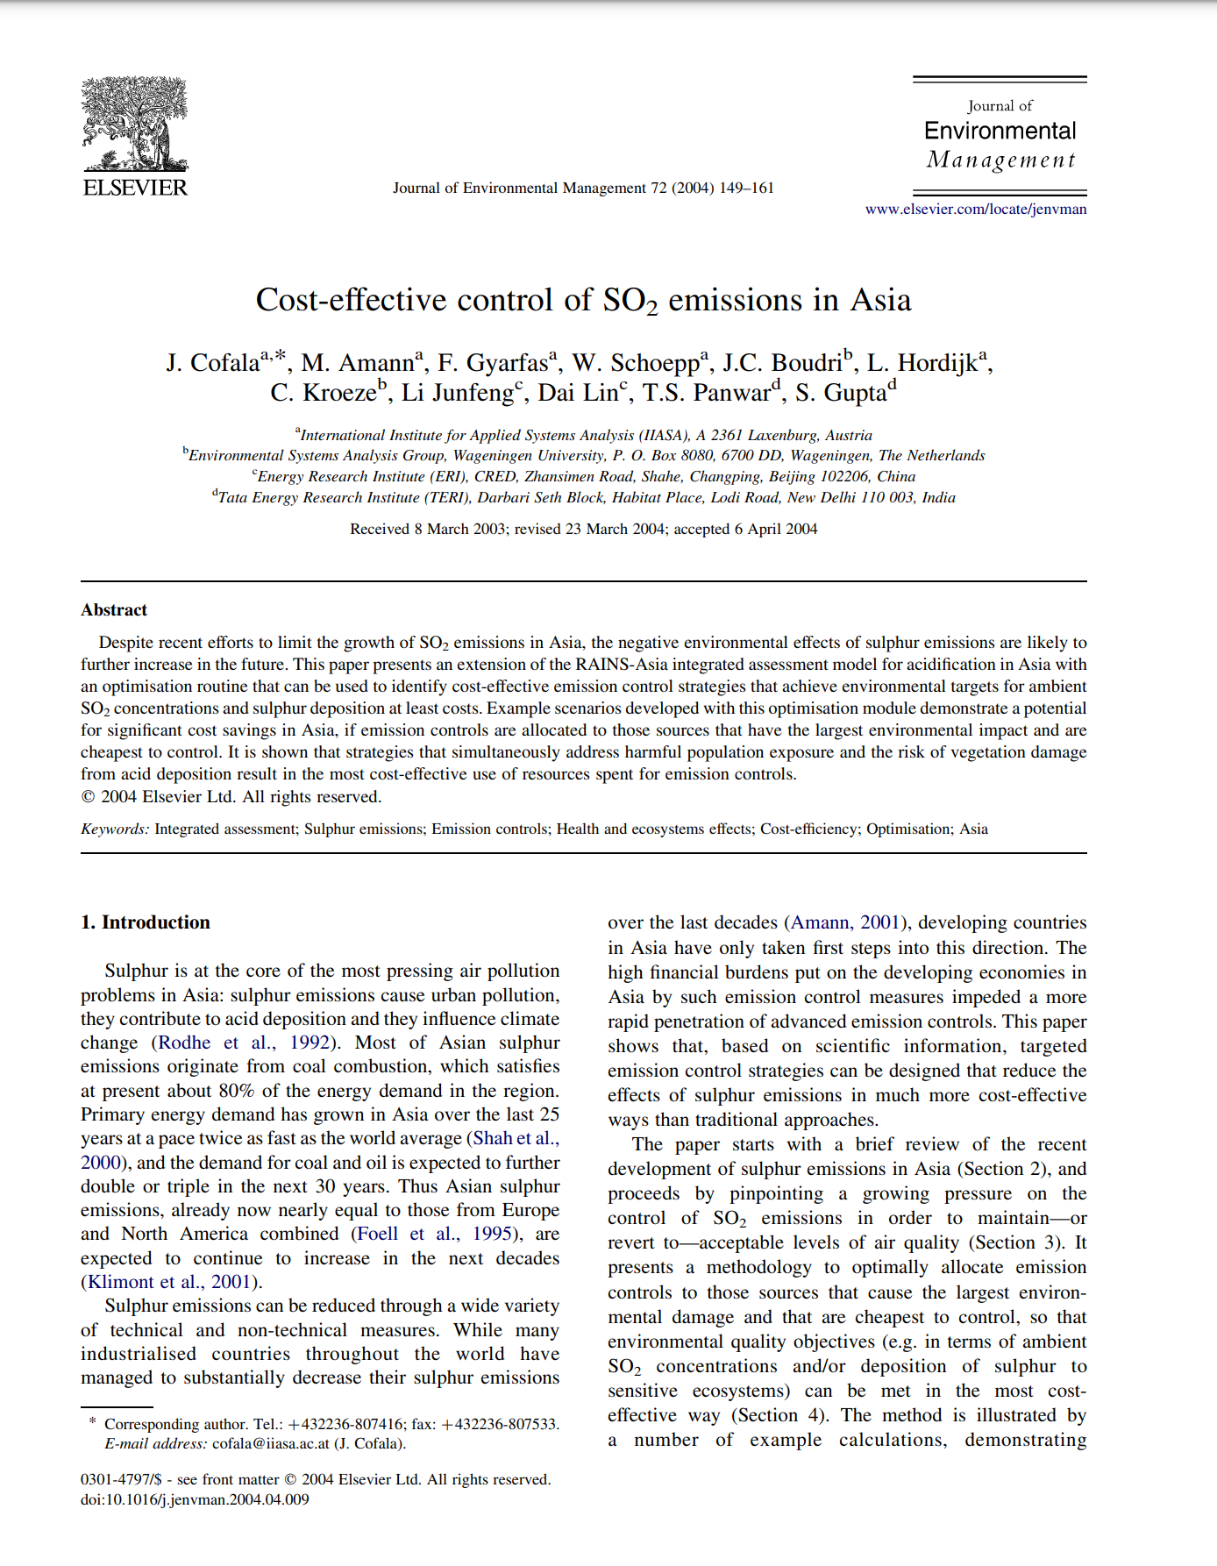
Summary
Significance
Abdurahman Alsulaiman
Interesting paper that discuss the possible ‘optimized’ paths in which human health and ecosystems could be protected from SO₂ emissions with lower financial commitment by developing economies, in comparison to the ‘computed’ use of the best available technologies.
ENV-723

Slide 3
RAINS-Asia model
Model structure
Externally supplied data
Projections of energy use
The model makes it possible to quantify for all emission sources the impacts of emission- and fuel standards imposed by legislation.
The results are resolved over a spatial resolution of 1⁰ longitude x 1⁰ latitude (approximately 70 –110 km x 110 km)
Abdurahman Alsulaiman
Databases on fuel quality
RAINS- Asia
SO₂ emissions
Assumptions on applied emission control measures
ENV-723

Slide 4

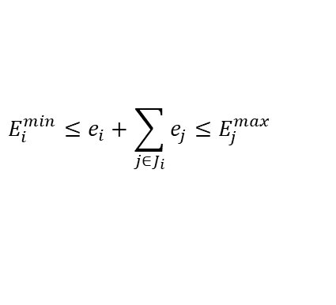


RAINS-Asia model
Formulation of the optimization problem
$$e_{i}^{min}≤e_{i}≤e_{i}^{max}$$
$e_{i}$ is the annual emissions of Sulphur dioxide of area I
Abdurahman Alsulaiman
$$e_{j}^{min}≤e_{j}≤e_{j}^{max}$$
$e_{j}$ is the annual emissions of Sulphur dioxide of large point j
Additional constraint in a given region. To set the upper limits to the emissions related to air pollution control plans developed by local or national authorities.
$$E_{i}^{min}≤e_{i}+\sum_{j∈J_{i}}{e_{j}}≤E_{j}^{max}$$
$E_{i}^{min}$, $E_{i}^{max}$ are the minimum and maximum emissions in region i
$J_{i}$ is the set of large point sources located in region i
ENV-723

Slide 5
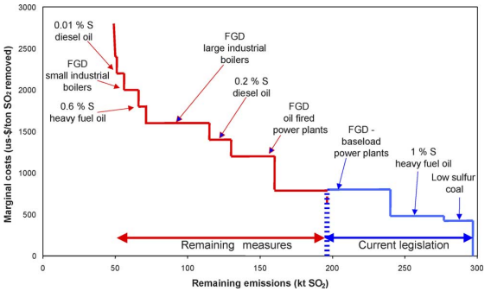
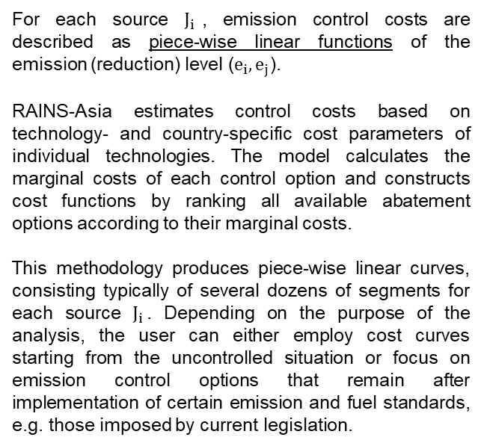
RAINS-Asia model
Formulation of the optimization problem
For each source $J_{i}$, emission control costs are described as piece-wise linear functions of the emission (reduction) level ($e_{i},e_{j}$).
RAINS-Asia estimates control costs based on technology- and country-specific cost parameters of individual technologies. The model calculates the marginal costs of each control option and constructs cost functions by ranking all available abatement options according to their marginal costs.
This methodology produces piece-wise linear curves, consisting typically of several dozens of segments for each source $J_{i}$. Depending on the purpose of the analysis, the user can either employ cost curves starting from the uncontrolled situation or focus on emission control options that remain after implementation of certain emission and fuel standards, e.g. those imposed by current legislation.
Abdurahman Alsulaiman
ENV-723

Slide 6

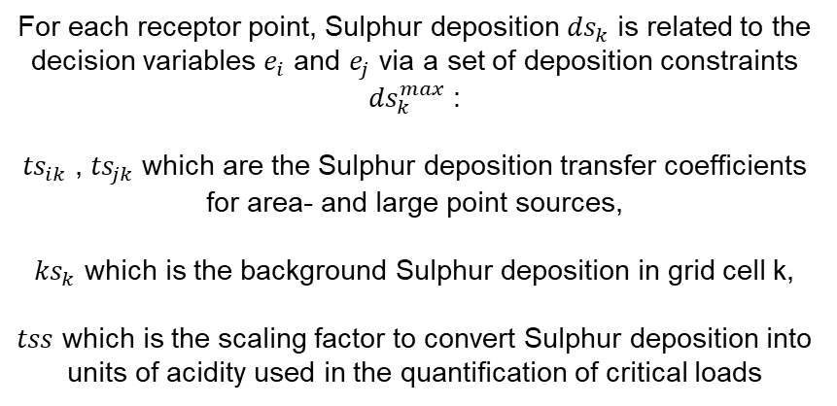
RAINS-Asia model
Formulation of the optimization problem
$${ds}_{k}=tss∗\left(\sum_{i}{{ts}_{ik}e_{i}+\sum_{i}{{ts}_{jk}e_{j}}}\right)+{ks}_{k}≤{ds}_{k}^{max}$$
For each receptor point, Sulphur deposition ${ds}_{k}$ is related to the decision variables $e_{i}$ and $e_{j}$ via a set of deposition constraints ${ds}_{k}^{max}$ :
${ts}_{ik}$ , ${ts}_{jk}$which are the Sulphur deposition transfer coefficients for area- and large point sources,
${ks}_{k}$ which is the background Sulphur deposition in grid cell k,
$tss$ which is the scaling factor to convert Sulphur deposition into units of acidity used in the quantification of critical loads
Abdurahman Alsulaiman
ENV-723

Slide 7
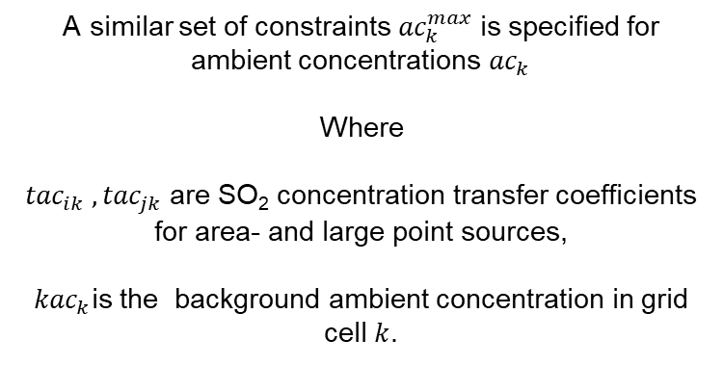

RAINS-Asia model
Formulation of the optimization problem
$${ac}_{k}=tss∗\left(\sum_{i}{{tac}_{ik}e_{i}+\sum_{i}{{tac}_{jk}e_{j}}}\right)+{kac}_{k}≤{ac}_{k}^{max}$$
A similar set of constraints ${ac}_{k}^{max}$is specified for ambient concentrations ${ac}_{k}$
Where
${tac}_{ik} , {tac}_{jk}$ are SO₂ concentration transfer coefficients for area- and large point sources,
${kac}_{k}$is the background ambient concentration in grid cell $k$.
Abdurahman Alsulaiman
ENV-723

Slide 8
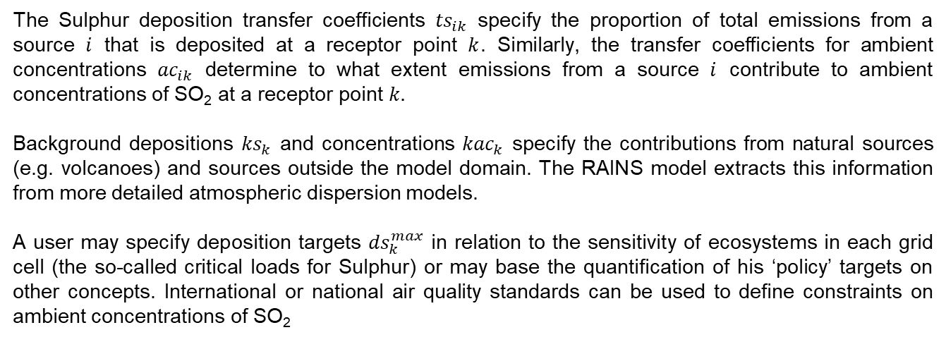
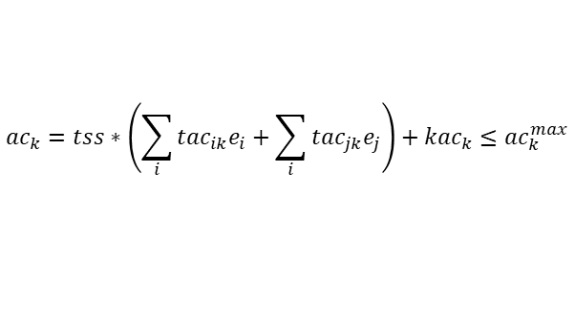
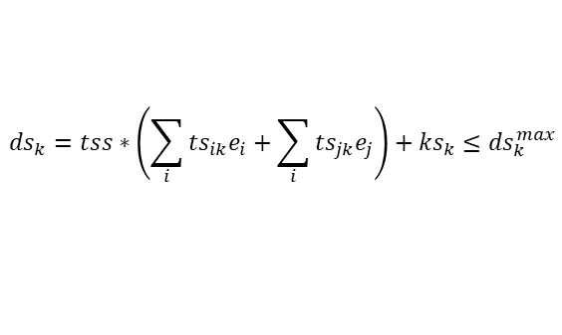
RAINS-Asia model
Formulation of the optimization problem
$${ds}_{k}=tss∗\left(\sum_{i}{{ts}_{ik}e_{i}+\sum_{i}{{ts}_{jk}e_{j}}}\right)+{ks}_{k}≤{ds}_{k}^{max}$$
$${ac}_{k}=tss∗\left(\sum_{i}{{tac}_{ik}e_{i}+\sum_{i}{{tac}_{jk}e_{j}}}\right)+{kac}_{k}≤{ac}_{k}^{max}$$
The Sulphur deposition transfer coefficients ${ts}_{ik}$ specify the proportion of total emissions from a source $i$ that is deposited at a receptor point $k$. Similarly, the transfer coefficients for ambient concentrations ${ac}_{ik}$ determine to what extent emissions from a source $i$ contribute to ambient concentrations of SO₂ at a receptor point $k.$
Background depositions ${ks}_{k}$ and concentrations ${kac}_{k}$ specify the contributions from natural sources (e.g. volcanoes) and sources outside the model domain. The RAINS model extracts this information from more detailed atmospheric dispersion models.
A user may specify deposition targets ${ds}_{k}^{max}$ in relation to the sensitivity of ecosystems in each grid cell (the so-called critical loads for Sulphur) or may base the quantification of his ‘policy’ targets on other concepts. International or national air quality standards can be used to define constraints on ambient concentrations of SO₂
Abdurahman Alsulaiman
ENV-723

Slide 9
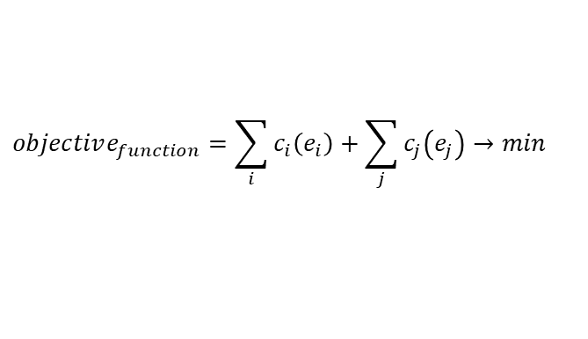
RAINS-Asia model
Formulation of the optimization problem
$$objective_{function}=\sum_{i}{c_{i}\left(e_{i}\right)}+\sum_{j}{c_{j}\left(e_{j}\right)}→min$$
In the optimization problem, the objective function is to minimize total costs of Sulphur emission reductions subject to the constraints specified for deposition and/or concentration
Abdurahman Alsulaiman
ENV-723

Slide 10
Model limitations and questions
Model limitations and questions
Comments
The model and algorithm was further described in earlier work done by the authors. Unfortunately, the cited work is inaccessible. Thus, there is a lack of clarity on the used algorithms.
With a model resolution of 1⁰ longitude x 1⁰ latitude (approximately 70 –110 km x 110 km), the authors had to apply a factor of 2-5x to average concentrations in urban areas. Given the large population concentration in urban areas, the multiplication factor provides a large range for the possible concentrations and thus a significant downside of using the model. (How would that be solved?)
Questions
Is the spatial resolution a function of the model or is it dependent on the external data?
Clarification on what piece-wise means?
Abdurahman Alsulaiman
ENV-723

